Slide 1

BCI433 - System i Business Computing
Week 8: Creating CLLE command
& RPGLE Programming with database files

Slide 2
Agenda
Creating a CLLE command
RPGLE Programming with database files

Slide 3
CL Command Review

Slide 4
Built-in Function: %SST
A substring function in CL
%SST(&variable start length)
Dcl &var1 *char len(20) value('IBC233')
Dcl &var2 *char len(5)
Chgvar &var1 (%sst(&var1 4 3))
What is the value of &var1?

Slide 5
Built-in Function: %trimr
Used to remove trailing spaces from a character string in RPG!
fname = 'Cindy ';
lname = 'Laurin ';
Then
fullname = %trimr(fname) + lname;
what would be the value of fullname?
More built-in function on IBM website

Slide 6
CL Command: DSPOBJD - RTVOBJD
Shows/retrieves compile information about an object.
Date compiled
Version of the operating system used when the object was compiled.
QCMD *PGM object
A special object – it’s OS version of the object can reflect current operating system level.

Slide 7
CL Command: DSPCMD
Displays information about a command including where the source code is!

Slide 8
Passing Parameters
CL program (e.g. PARMCL) code:
pgm (&parm1 &parm2)
dcl &parm1 *dec (5 2)
dcl &parm2 *char 5
To call this program
CALL PARMCL (X'10002F' 'TEST')

Slide 9
CL Commands
A CL command consists of a program with a compiled object.
Command Source
Builds the command entry screen
Calls the compiled object
Interpreted

Slide 10
Creating CL Commands
To create/define a user-defined command, you need to:
enter command definition statements into a source file and compile them into an commend object,
run a Create Command (CRTCMD) command using the object and an program as inputs.

Slide 11
Command Definition
The command definition of each command contains one or more command definition statements:
One and only one Command (CMD) statement
A Parameter (PARM) statement for each parameter that appears on the command being created.
Other optional statements, such as DEP, ELEM, QAUL statements.

Slide 12
Syntax for Command Definition
CMD PROMPT( )
PARM KWD ( ) +
MIN( ) +
TYPE( ) +
LEN( ) +
RSTD( ) +
VALUES( ) +
DFT( ) +
PROMPT( )
PARM Reference:
Keyword | Description
KWD | Keyword
TYPE | Type of value
MIN | Minimum values required
LEN | Value length
RSTD | Restricted values
DFT | Default value
VALUES | Valid values
PROMPT | Prompt specifications

Slide 13
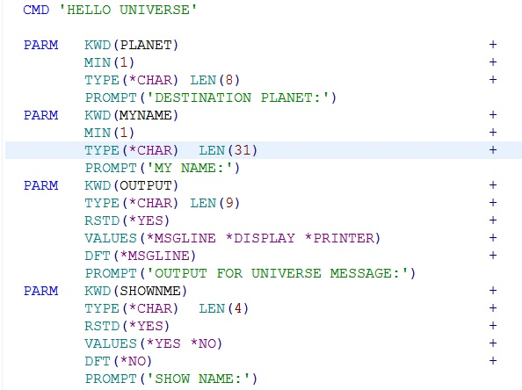
Example: HELLOCMD.cmd Create Source PF QLAB8

Slide 14
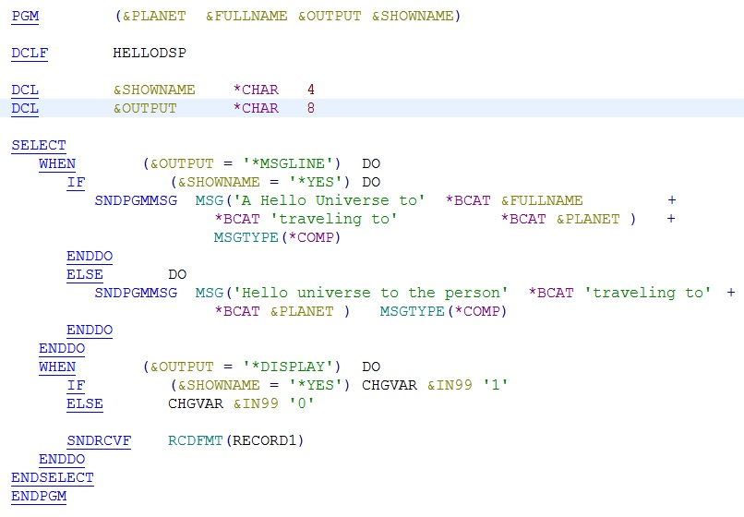
Example: HELLOCPP.clle

Slide 15
Example: HELLODSP.dspf
A R RECORD1
A 4 22'H e l l o U n i v e r s e'
A PLANET 8 O 7 39
A 7 18'Destination Planet:'
A 99 9 18'Passenger Name:'
A 99 FULLNAME 31 O 9 39
Create the command by entering the following command:
CRTCMD CMD(HELLOCMD) PGM(HELLOCPP) SRCFILE(QLAB8)
Note: QLAB8.file.ph-src is where your put your source files

Slide 16
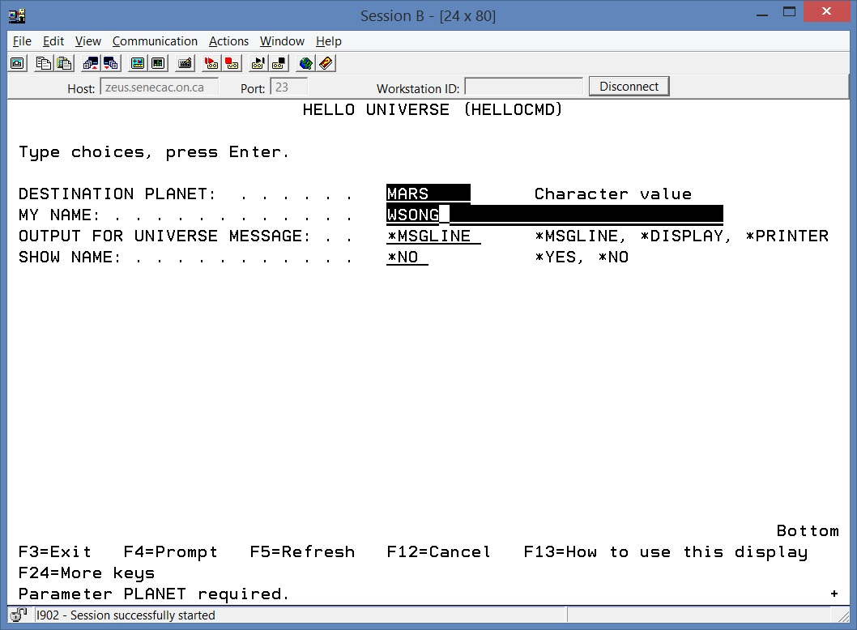
Run the Command

Slide 17
F-SPEC Review
File name – name of file
File Type - C for a Display file
I, U, or O for Database Objects
O, for Printer Files (reports)
File Designation – F for Full procedural file
File Format - E for Externally Described
Record Address Type - K if the object has a sort
Device - Disk for Database Object
Workstn for display files
Printer for reports

Slide 18
RPG Verbs and Functions
Read filename;
reads a record from a database object
%EOF(filename)
Checks for End of File

Slide 19
Reference for display files
Reference fields in an display file – the fields that can be defined by referring to the fields specified in a previously created database/pf file.
The field attributes referred to are the length, data type, and decimal positions of the field.
You can specify R in this position 29 in order to use the reference function.
Packed decimal and binary fields are not supported for display files. Therefore,
when you refer to fields of these types, the data type assigned is zoned decimal with a keyboard shift as follows: Y in position 35

Slide 20
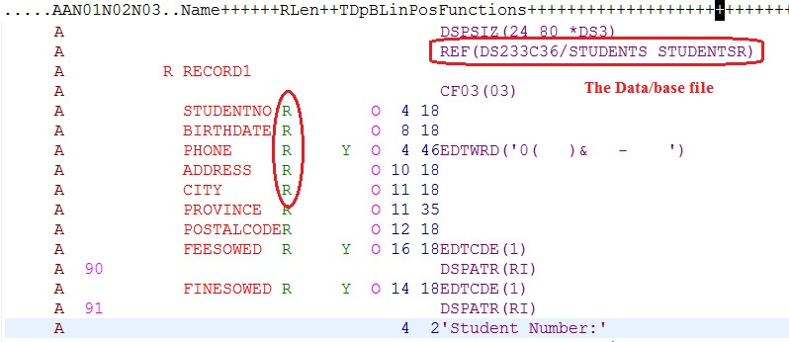
Example of Reference Fields
STUDENTS.PF data file was defined in Lab 2.

Slide 21
Thank You!

